Slide 1

TOOLS FOR MY19 E-RIDE
Notes:
No shortcuts = do the right thing for the right reason / no compromise

Slide 2
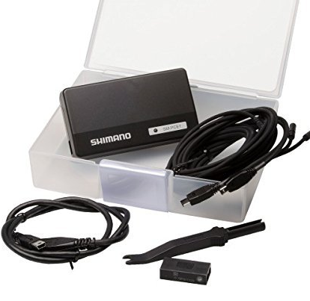
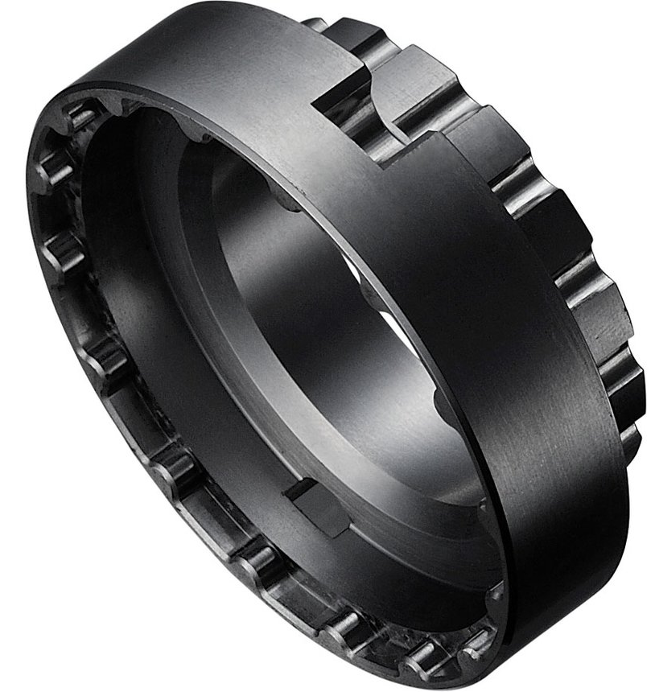
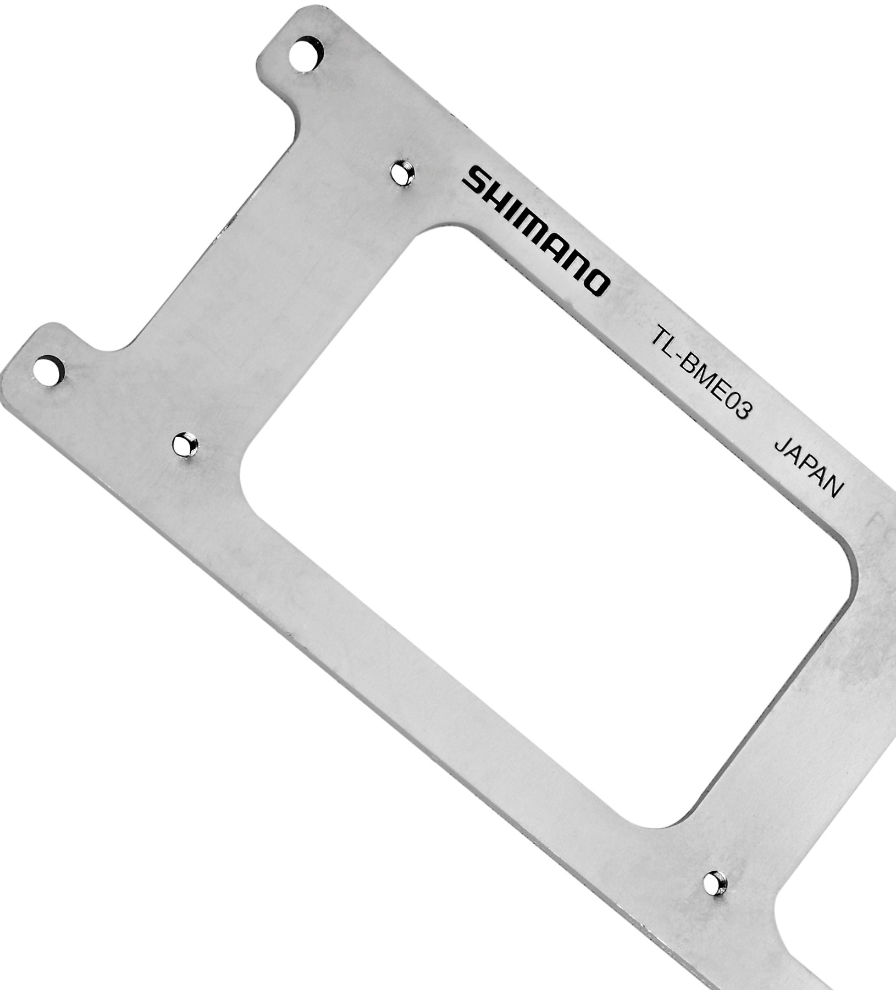
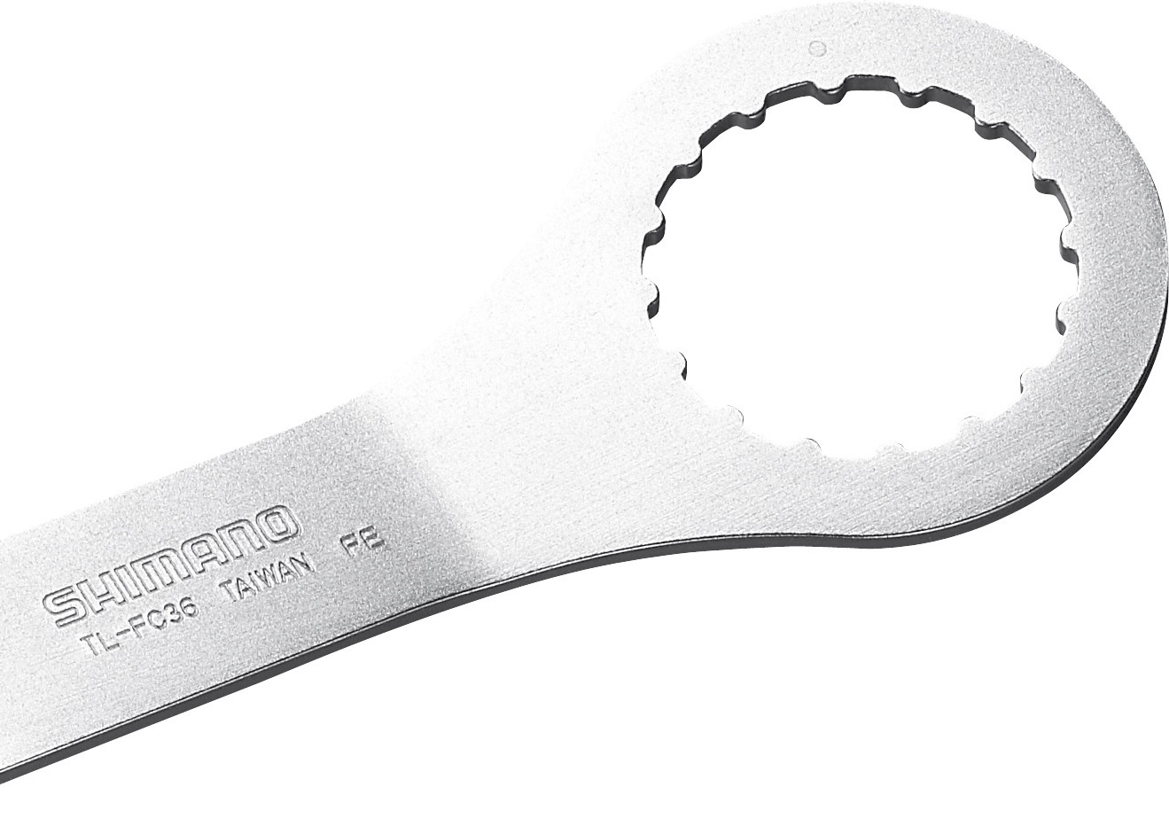
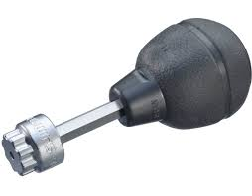
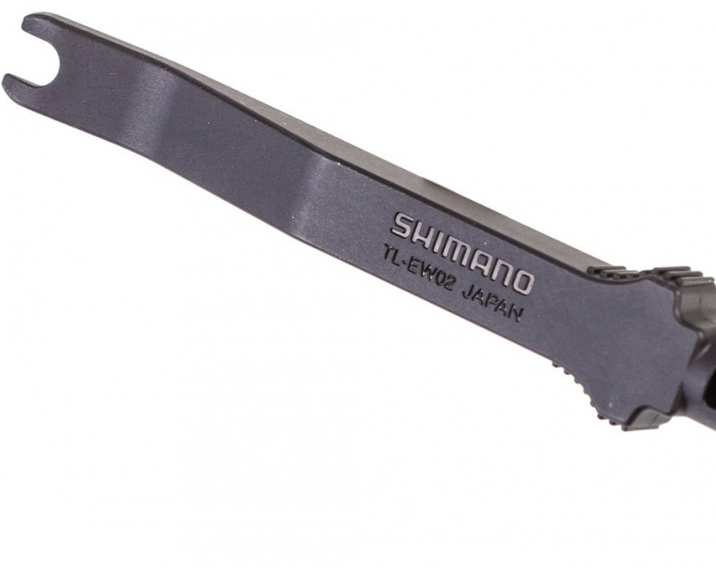
SHIMANO STEPS E-8000
TOOL OVERVIEW
SM-PCE1
TL-FC39
TL-BME03
TL-FC36
TL-FC18
TL-EW02

Slide 3

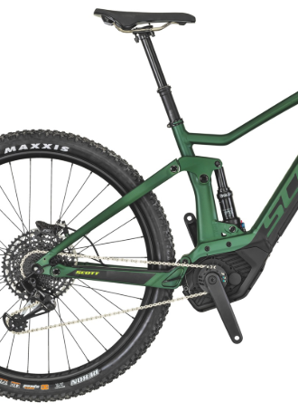
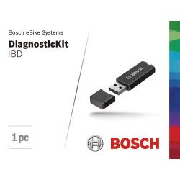
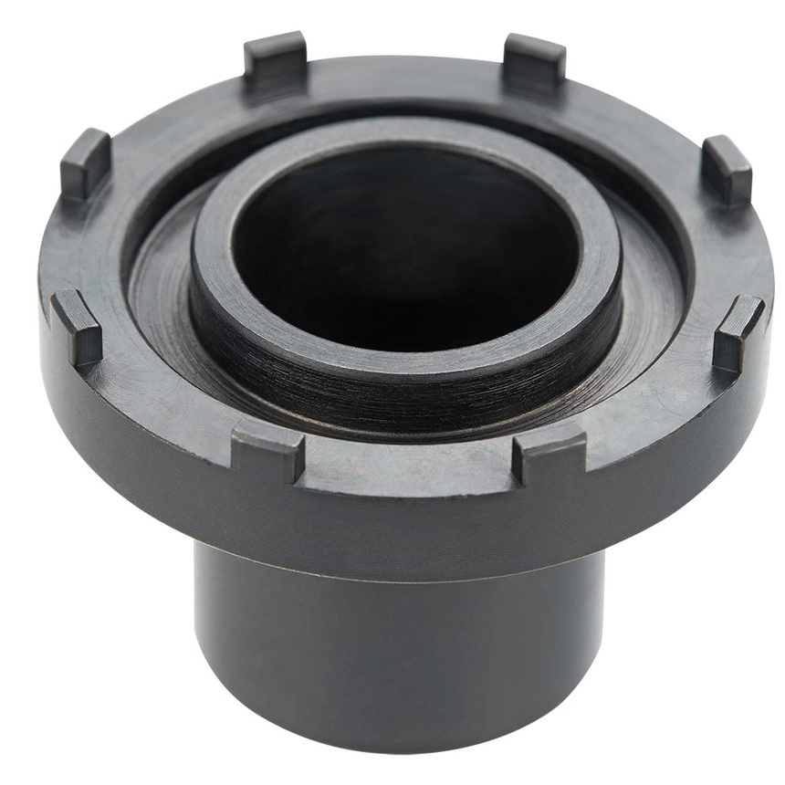
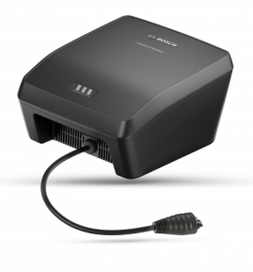
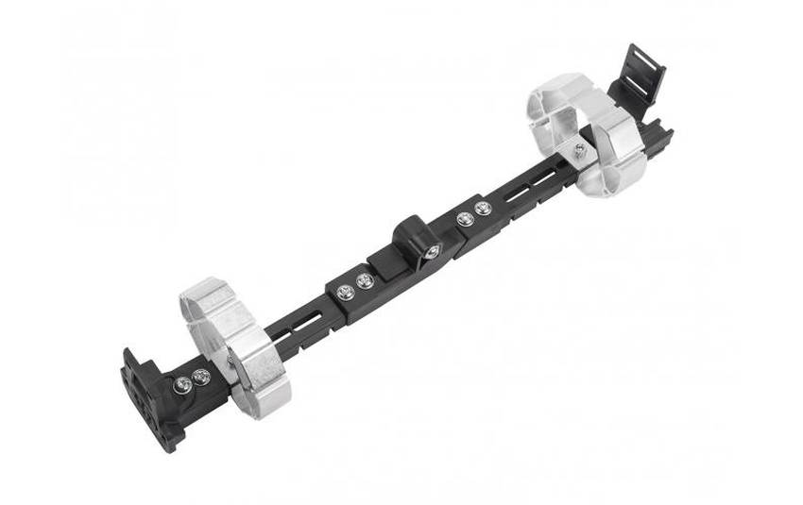
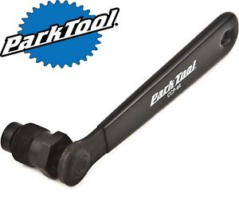
bosch performance cx
TOOL OVERVIEW
0.275.008.405
0.275.009.003
0.275.007.924
0.275.008.405
0.275.008.405
Park Tool

Slide 4
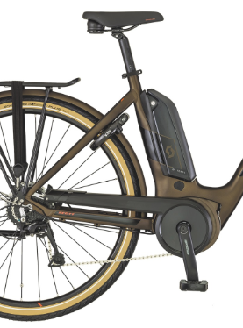
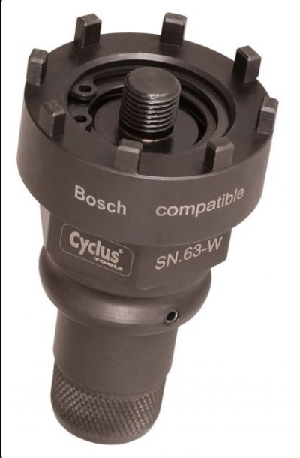
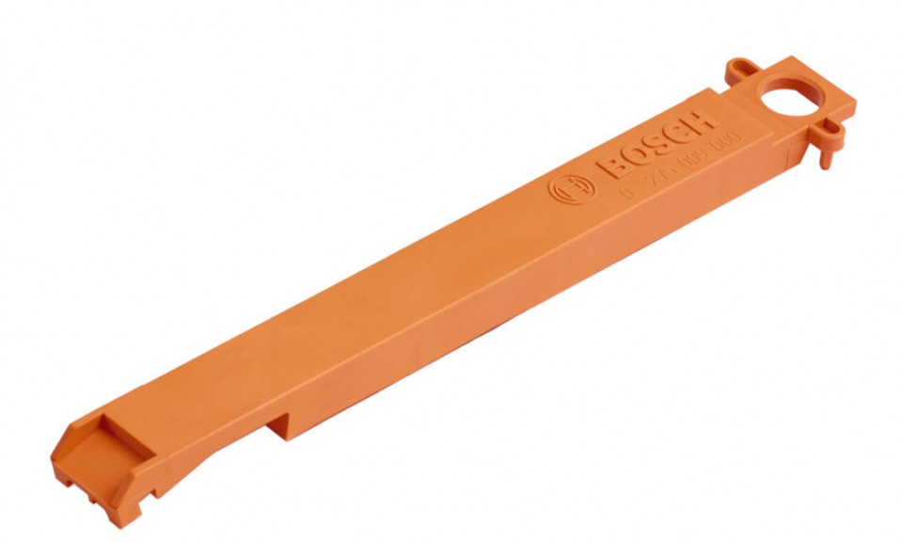
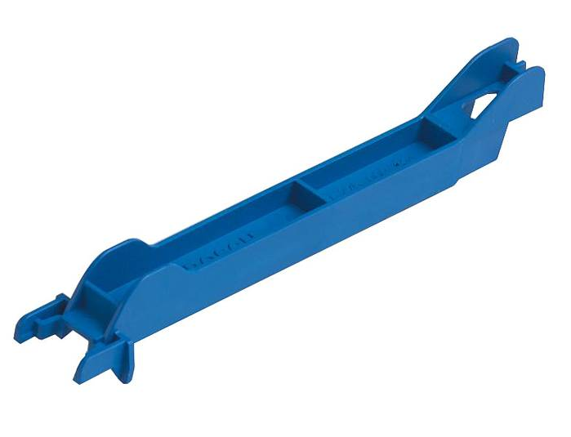
bosch active line/plus
TOOL OVERVIEW
0.275.008.405
Cyclus Tools
0.275.007.924
0.275.009.000
0.275.009.004
Park Tool

