Slide 1

X-FUSION 2019 Product Information
Scott Tech Seminar

Slide 2
2019 XF Scott Products
Fork for below model:
 | Fork
Spark 600 | Velvet RL
Voltage YZ 0.1 | Slant RL
Gambler | RV-1 HLR

Slide 3
2019 XF Scott Products
Rear shock for below model:
 | N/A | Contessa | E-Ride | Contessa E-Ride
Spark | O2 Nude RLX/O2pro RL | O2 Nude RLX | O2 Nude RLX | O2 Nude RLX
Genius | O2 Nude RLX | O2 Nude RLX
Ransom | O2 Nude RLX
Strike |  |  | O2 Nude RLX | O2 Nude RLX
Axis |  |  | O2 Nude RLX
Gambler | Vector R

Slide 4
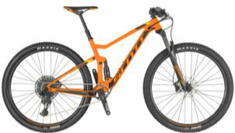
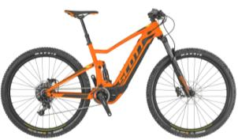
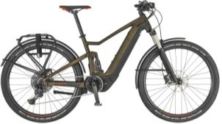
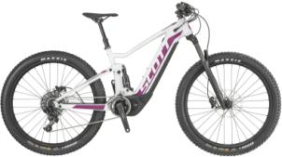
02 Pro Trunnion Nude RLX 165/45
Spark 960
Spark eRide 930
Axis eRide EVO
Contessa Spark eRide 710
Contessa Spark930

Slide 5
02 Pro Trunnion Nude RLX 165/45
Custom three-position adjustable shock with trunnion mounting and 165X45 metric sizing
Open: open compression/open air spring
Middle: middle compression/open air spring
Closed: firm compression/closed air spring
Rebound : 6 click
Uses Scott Twin Lock remote

Slide 6
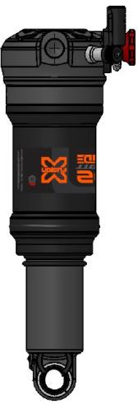
Scott Models Using 02 Pro Trunnion Nude 165/45
Spark 960
Contessa Spark 930
Spark E-Ride 930
Axis E-Ride EVO
Contessa Spark E-Ride 710

Slide 7
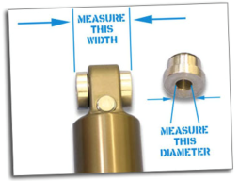
Size Specifications
Spark 960
Contessa Spark 930
Model Length/Stroke
165X45
reducers use 10mm bolt by 20mm width

Slide 8
Size Specifications
Spark E-Ride 930
Axis E-Ride EVO
Contessa Spark E-Ride 710
Model Length/Stroke
165X45
reducers use 8mm bolt by 30mm width

Slide 9
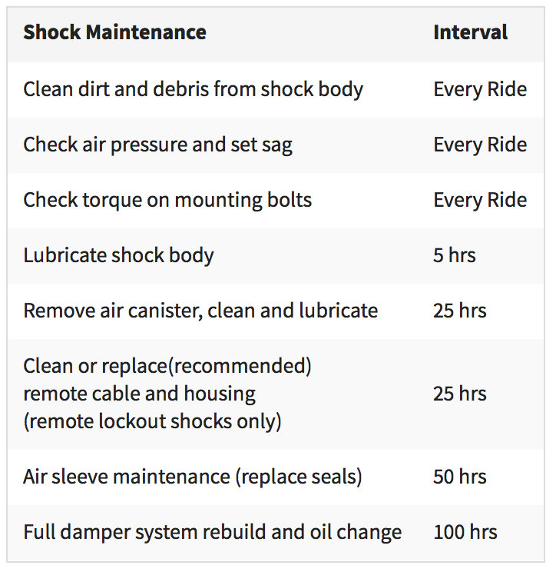

Slide 10
02 Pro Trunnion Nude RLX 165/45 Service Parts
Scott trunnion Nude Service Parts | Part Number | Description | Cost
Air Seal Kit | 42-O2PTNU-AIR-701 | 02 trunnion Nude Shock Air Seal Kit | $4.00
Damper Seal Kit | 42-O2PTNU-DMP-701 | 02 trunnion Nude Shock Damper Seal Kit | $5.00
Piston with Shim Kit | 42-O2PNUPISTON-601 | Complete Piston with Shims | $6.00
Nude Eyelet Kit | 42-O2PTNUEYELET-701 | Eyelet For All trunnion Nude Shock Sizes | $30.00
165mm Air Sleeve | 42-O2PTNUSLEEVE-702 | Air Sleeve for 165X45 trunnion Nude Shock | $16.00
165mm Shaft and Needle Kit | 42-O2PTNUSHAFT-702 | Shaft and Needle Kit for 165X45 Nude | $8.00
165mm Body +IFP | 42-O2PTNUBODY-702 | Body + IFP for 165X45 trunnion Nude Shock | $8.00
Knob kits | 42-O2PTNUREMOTE-701 | Lock-out and rebound knob assembly | $8.00

Slide 11
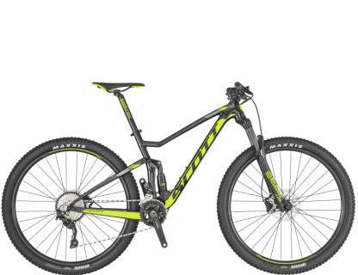
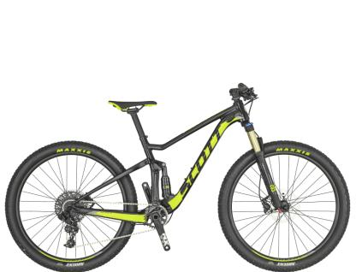
02 Pro Trunnion RL 165/45
Spark 970
Spark 600

Slide 12
02 Pro Trunnion RL 165/45
Lock-out and rebound adjustable shock with trunnion mounting and 165X45 metric sizing
Lock-out : open and lock-out
Rebound : 6 click

Slide 13
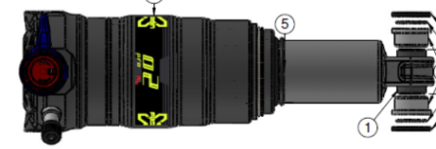
Scott Models Using 02 Pro Trunnion RL 165/45
Spark 970
Spark 600

Slide 14
Size Specifications
Model Length/Stroke
All Spark Models 165X45
reducers use 10mm bolt by 20mm width

Slide 16
02 Pro Trunnion RL 165/45 Service Parts
Scott trunnion Nude Service Parts | Part Number | Description | Cost
Air Seal Kit | 42-O2PTNU-AIR-701 | 02 trunnion Nude Shock Air Seal Kit | $4.00
Damper Seal Kit | 42-O2PTNU-DMP-701 | 02 trunnion Nude Shock Damper Seal Kit | $5.00
Piston with Shim Kit | 42-O2PNUPISTON-601 | Complete Piston with Shims | $6.00
Nude Eyelet Kit | 42-O2PTNUEYELET-701 | Eyelet For All trunnion Nude Shock Sizes | $30.00
165mm Air Sleeve | 42-O2PTNUSLEEVE-702 | Air Sleeve for 165X45 trunnion Nude Shock | $16.00
165mm Shaft and Needle Kit | 42-O2PTNUSHAFT-702 | Shaft and Needle Kit for 165X45 Nude | $8.00
165mm Body +IFP | 42-O2PTNUBODY-702 | Body + IFP for 165X45 trunnion Nude Shock | $8.00

Slide 17
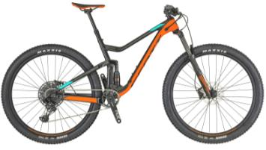
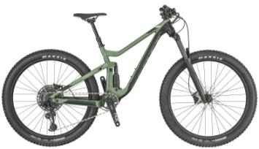
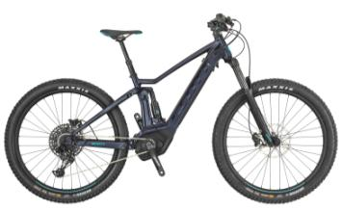
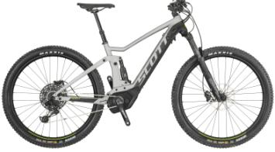
02 Pro Trunnion Nude RLX 185/55
Genius 760
Genius Contessa 730
Strike eRide 730/930
Strike Contessa eRide 720

Slide 18
02 Pro Trunnion Nude RLX 185/55
Custom three-position adjustable shock with trunnion mounting and 185X55 metric sizing
Open: open compression/open air spring
Middle: middle compression/open air spring
Closed: firm compression/closed air spring
Rebound : 6 click
Uses Scott Twin Lock remote

Slide 19
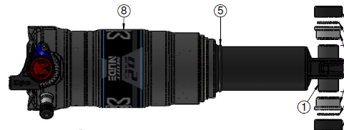
Scott Models Using 02 Pro Trunnion Nude 185/50
Genius 760
Contessa Genius 730
Strike eRide 730
Strike eRide 930
Strike Contessa eRide 720

Slide 20
Size Specifications
Genius 760 185X55
Contessa Genius 730
Strike eRide 730
Strike eRide 930
Strike Contessa eRide 720
Model Length/Stroke
All reducers use 8mm bolt by 30mm width

Slide 22
02 Pro Trunnion Nude RLX 185/55 Service Parts
Scott trunnion Nude Service Parts | Part Number | Description | Cost
Air Seal Kit | 42-O2PTNU-AIR-701 | 02 trunnion Nude Shock Air Seal Kit | $4.00
Damper Seal Kit | 42-O2PTNU-DMP-701 | 02 trunnion Nude Shock Damper Seal Kit | $5.00
Piston with Shim Kit | 42-O2PNUPISTON-601 | Complete Piston with Shims | $6.00
Nude Eyelet Kit | 42-O2PTNUEYELET-701 | Eyelet For All trunnion Nude Shock Sizes | $30.00
185mm Air Sleeve | 42-O2PTNUSLEEVE-801 | Air Sleeve for 185X55 trunnion Nude Shock | $40.00
185mm Shaft and Needle Kit | 42-O2PTNUSHAFT-801 | Shaft and Needle Kit for 185X55 Nude | $16.00
185mm Body +IFP | 42-O2PTNUBODY-801 | Body + IFP for 185X55 trunnion Nude Shock | $8.00
Knob kits | 42-O2PTNUREMOTE-701 | Lock-out and rebound knob assembly | $8.00

Slide 23
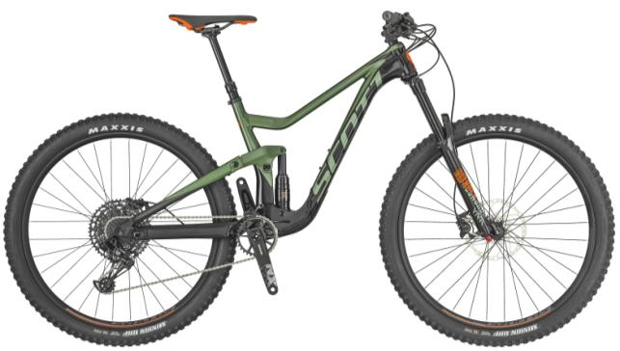
02 Pro Trunnion Nude RLX 205/65
Ransom 930

Slide 24
02 Pro Trunnion Nude RLX 205/65
Custom three-position adjustable shock with trunnion mounting and 205x65 metric sizing
Open: open compression/open air spring
Middle: middle compression/open air spring
Closed: firm compression/closed air spring
Rebound : 6 click
Uses Scott Twin Lock remote

Slide 25
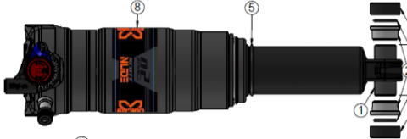
Scott Models Using 02 Pro Trunnion Nude 205/65
Ransom 930

Slide 26
Size Specifications
Ransom 930 205X65
Model Length/Stroke
reducers use 8mm bolt by 30mm width

Slide 28
02 Pro Trunnion Nude RLX 185/85 Service Parts
Scott trunnion Nude Service Parts | Part Number | Description | Cost
Air Seal Kit | 42-O2PTNU-AIR-701 | 02 trunnion Nude Shock Air Seal Kit | $4.00
Damper Seal Kit | 42-O2PTNU-DMP-701 | 02 trunnion Nude Shock Damper Seal Kit | $5.00
Piston with Shim Kit | 42-O2PNUPISTON-601 | Complete Piston with Shims | $6.00
Nude Eyelet Kit | 42-O2PTNUEYELET-701 | Eyelet For All trunnion Nude Shock Sizes | $30.00
205mm Air Sleeve | 42-O2PTNUSLEEVE-901 | Air Sleeve for 205X65 trunnion Nude Shock | $40.00
205mm Shaft and Needle Kit | 42-O2PTNUSHAFT-901 | Shaft and Needle Kit for 205X65 Nude | $16.00
205mm Body +IFP | 42-O2PTNUBODY-901 | Body + IFP for 205X65 trunnion Nude Shock | $8.00
Knob kits | 42-O2PTNUREMOTE-701 | Lock-out and rebound knob assembly | $8.00

Slide 29
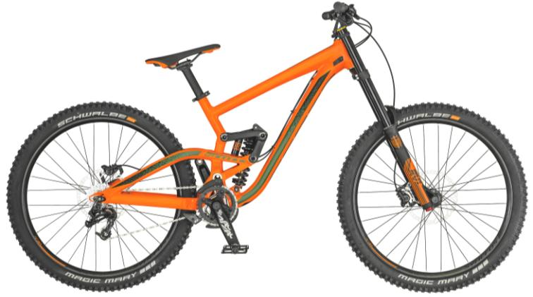
RV-1 HLR Fork & Vector R rear shock
Gambler 730

Slide 30
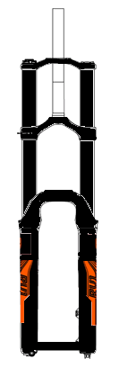
RV-1 HLR Fork Features
200mm travel, 36mm stanchion tubes
High/Low speed compression adjustable
Rebound adjustable
Coil spring
1-1/8 steer and 20x110mm axle(non Boost)
Custom decals for Scott

Slide 31
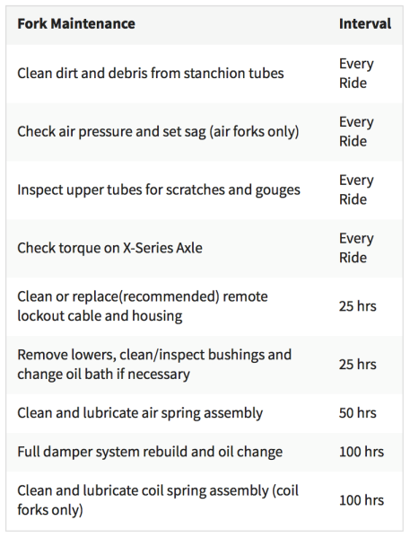

Slide 32
RV-1 HLR Service Parts
RV-1 HLR Service Parts | Part Number | Cost
RV1 short crown/steerer/assembly Matte black 1 1/8th | 42-SSFRVB0-CSU-601 | $40.00
RV-1/Metric Flat Black Lower 20mm | 42-SSFMT00-LEG-501 | $86.67
RV1 200mm Soft Spring: Red | 42-RV1SSPRING-401 | $12.00
RV1 200mm Soft Spring: Green | 42-RV1SSPRING-402 | $12.00
RV1 200mm Soft Spring: Blue | 42-RV1SSPRING-403 | $12.00
RV1 200mm Soft Spring:Orange | 42-RV1SSPRING-404 | $12.00
RV1 200mm Soft Spring: White | 42-RV1SSPRING-405 | $12.00
RV1 Roughcut HLR Damper Cartridge | 42-SSFDRVHLR-200-601 | $140.00
36mm Lower Leg/Casting Seal Kit | 42-SSFVG00-LEG-301 | $7.00
34/36 Roughcut Compression Knob Kit | 42-SSFSWHL-KNOB-601 | $10.00
RV-1/Metric Roughcut Rebound Knob Kit | 42-SSFMTR0-KNOB-601 | $8.00
RV-1 Roughcut HLR Bladder Rubber Kits | 42-SSFDRVHLR-DMP-601 | $12.00
RV1&Metric Brake hose guide kit with screw | 42-SSFRV00-GUIDE-401 | $4.00

Slide 33
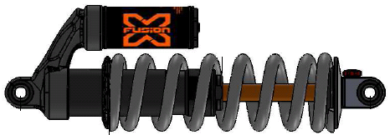
Vector R rear shock
Rebound adjustable shock with standard mounting and 240x76 sizing

Slide 34
Size Specifications
Gambler 730 240X76
Model Length/Stroke
reducers use 8mm bolt by 22.2mm width at top 59.94mm width at bottom

Slide 36
Vector R Service Parts
Vector R Service Parts | Part Number | Description | Cost
Vector DAMPING SEAL | 42-VT Series-Dmp-101 | Vector HLR/RC DAMPING SEAL | $5.00
Vector Shaft | 42-VTSHAF-240-201 | Vector Shaft sub-assembly 240mm | $6.00
Vector EyeLet | 42-VTEYE-201 | Vector EyeLet Rebound side | $6.00

Slide 37
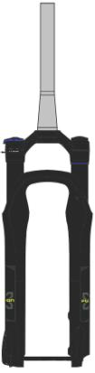
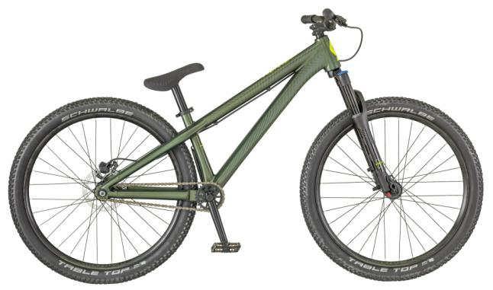
Slant RL
Voltage YZ 0.1

Slide 38
Slant RL Features
100mm travel, 34mm stanchion tubes
Air spring/compression/rebound adjustable
New closed RL damper cartridge
Tapered steer and 15mm axle
Custom decals for Scott

Slide 40
Slant RL Service Parts
Slant Service Parts | Part Number | Cost
34mm Lower Leg/Casting Seal Kit | 42-SSFTC00-LEG-301 | $7
34mm RL2 Damper Seal Kit | 42-SSFDSWRL-DMP-801 | $8
34mm Air spring Seal Kit | 42-SSFTCRL-AIR-301 | $6
34mm Lockout Knob Kit | 42-SSFSWL0-KNOB-601 | $8
34 rebound Knob Kit | 42-SSFSWR0-KNOB-601 | $5
32/34 Air Knob Kit | 42-SSFVT00-KNOB-303 | $6
Brake hose guide kit with screw | 42-SSFVT00-GUIDE-301 | $4
15mm axle kits 1.5 Thread Lock X-15 | 42-SSFQ15100-140-401 | $15
34mm RL Damper Cartridge for Slant/Sweep/McQueen 160mm | 42-SSFDSWRL-160-801 | $80
Slant crown/steerer/assembly Flat black tapered | 42-SSFSN00-CSU-803 | $80
Slant Flat Black 15mm lower | 42-SSFSNQ0-LEG-803 | $80

Slide 41
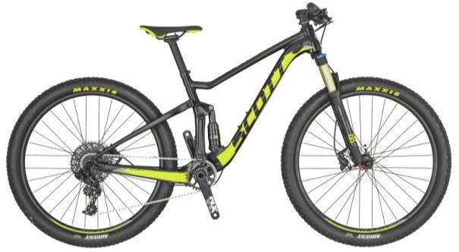
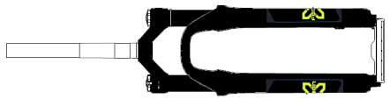
Velvet RL
Spark 600

Slide 42
Velvet RL Features
100mm travel, 32mm stanchion tubes
Special negative coil spring for kid bike
Air spring/compression/rebound adjustable
1-1/8 steer and 9mm drop out
Custom decals for Scott

Slide 44
Velvet RL Service Parts
Velvet Service Parts | Part Number | Cost
32mm Lower Leg/Casting Seal Kit | 442-SSFVT00-LEG-301 | $7
32mm RL2 Damper Seal Kit(2 pieces damper) | 442-SSFCVTRL-DMP-301 | $8
32mm Air spring Seal Kit | 42-SSFCVTRL-AIR-301 | $6
32 Lockout Knob Kit | 42-SSFSDL0-KNOB-601 | $8
32 rebound Knob Kit | 42-SSFSDR0-KNOB-601 | $5
32/34 Air Knob Kit | 42-SSFVT00-KNOB-303 | $6
Brake hose guide kit with screw | 42-SSFVT00-GUIDE-301 | $4
32mm RL Damper Upper & Lower Half(2018 VT/ST/SD/X32) | 42-SSFDSTRL-140-601 | $55
Velvet crown/steerer/assembly Flat black 1 1/8th | 42-SSFVT00-CSU-801 | $66.67
Velvet Flat Black 9mm lower | 42-SSFVT00-LEG-803 | $66.67

Slide 45
References
International Service Centers
http://www.xfusionshox.com/distributors-service-centers
Complete Product Drawings
http://www.xfusionshox.com/distributor-login
User: dist
Password: xfdist

